Slide 1
Light Gradient Boosting Regression

Slide 2
What is LightGBM Regression?
It is an open source, high-performance gradient boosting framework designed for efficient and scalable machine learning tasks. It is specially tailored for speed and accuracy, making it a popular choice for both structured and unstructured data in diverse domains.
LightGBM uses a histogram-based method in which data is bucketed into bins using a histogram of the distribution.
LightGBM is a gradient boosting framework developed by Microsoft.
It's optimized for speed, low memory usage, and high accuracy, especially on large datasets.
It can handle both regression and classification tasks.
In regression, LightGBM tries to predict continuous values (like house prices, sales forecasting, etc.).

Slide 3
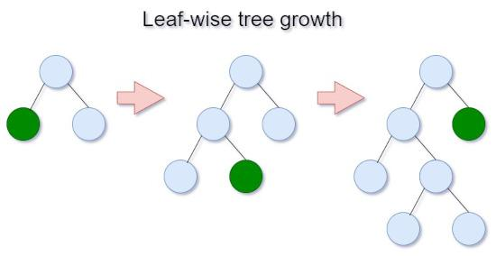

Slide 4
How LightGBM Regression Works (Simple Flow):
Start with an initial prediction (e.g., mean value of target).
Compute residuals (errors between predictions and true values).
Fit a decision tree to predict the residuals (the errors).
Update the predictions by adding the tree’s output (with a learning rate).
Repeat steps 2–4 for several rounds, gradually improving the model.
It's based on Gradient Boosting Decision Trees (GBDT) but uses smart tricks like:
Histogram-based splitting (faster than regular decision tree growth).
Leaf-wise tree growth (grows the leaf with the maximum loss reduction).

Slide 5
Hyperparameters:
Parameter | Meaning
boosting_type | "gbdt" (standard gradient boosting), or "dart" (dropouts)
num_leaves | Controls the complexity of the tree (larger = more complex)
learning_rate | Step size for each boosting round (smaller = slower but more accurate)
max_depth | Limits the depth of trees
n_estimators | Number of boosting rounds (trees)
feature_fraction | Randomly select a fraction of features for each tree (for regularization)
bagging_fraction | Randomly select a fraction of data for each tree (for regularization)

Slide 6
LightGBM vs XGBoost
Feature | LightGBM | XGBoost
Developer | Microsoft | DMLC community
Speed | Faster (especially for large datasets) | Fast, but LightGBM usually faster
Memory | Lower | Higher
Tree Growth | Leaf-wise (best split first) | Level-wise (grow depth-by-depth)
Handling Large Data | Excellent (built for it) | Good, but can be slower
Accuracy | Very high (but can overfit if not careful) | Very high and stable

Slide 7
LightGBM vs XGBoost
Feature | LightGBM | XGBoost
Ease of Tuning | More sensitive to hyperparameters | A bit easier, more robust to bad tuning
Support for Categorical Features | Native support (no need for one-hot encoding) | Needs manual encoding (like OneHot or LabelEncoding)
GPU | Yes (very good) | Yes (good)
Parallel Learning | Faster due to histogram-based method | Good but slightly slower
Best for | Extremely large datasets | Most general-purpose tasks

